Slide 1
DEEP LAB CUTS
:Neural Networks,Social Behaviors and Animals
DATA 607
DATA IN CONTEXT
Zainab

Slide 2
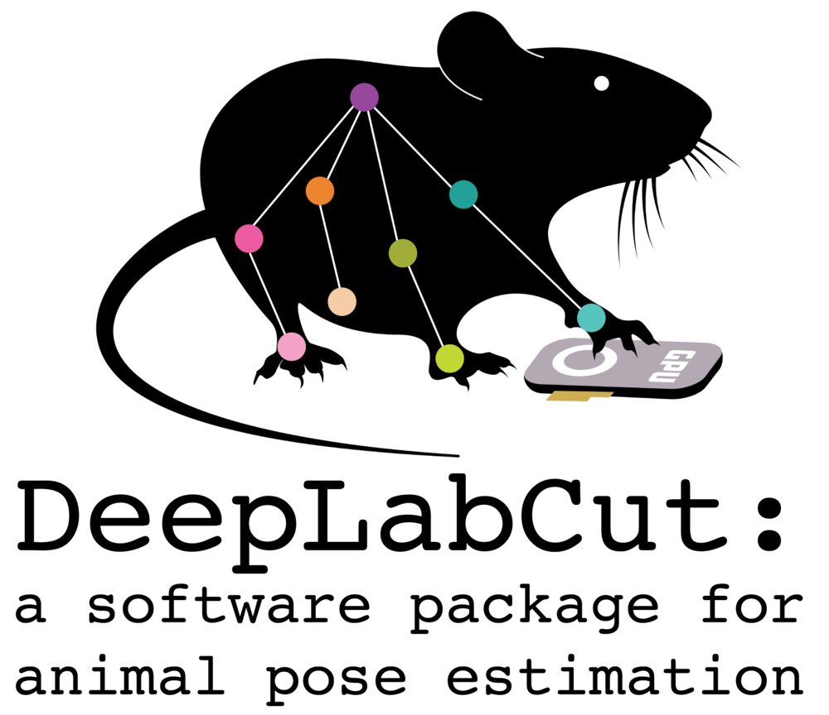
Introducing Deep Lab Cut : a open source python package for animal estimation
Notes:
DeepLabCut™ is an efficient method for 2D and 3D markerless pose estimation based on transfer learning with deep neural networks that achieves excellent results (i.e. you can match human labeling accuracy) with minimal training data (typically 50-200 frames). We demonstrate the versatility of this framework by tracking various body parts in multiple species across a broad collection of behaviors.

Slide 3

Introducing Mathias Lab
- Neuroscience & Neuroengineering
- Computational Neuroscience (NeuroAI)
- Computer Vision
Notes:
aim to enable neuroscience research with AI. Our goal is to understand mechanisms underlying adaptive behavior in intelligence systems.
They reverse engineer the neural circuits that drive adaptive behavior by studying artificial and natural intelligence
Question:
How do animals learn to adapt? How does the brain construct and adapt internal models of the world, which enable us to compensate for sensory delays and make better predictions?
We develop skilled motor tasks where mice can learn from dynamically changing sensory and reward landscapes. We also study adaptive natural behaviors. In particular, we are interested in continual learning in both biological and artificial agents. The work in this area is focused on using mice as a model system for motor learning and adaptation (combining behavioral assays with large-scale neural recordings using electrophysiology and 2-photon mesoscopy). Collectively, we take an approach called reverse engineering where we perform theory-guided experiments and refine our knowledge of the system.

Slide 4
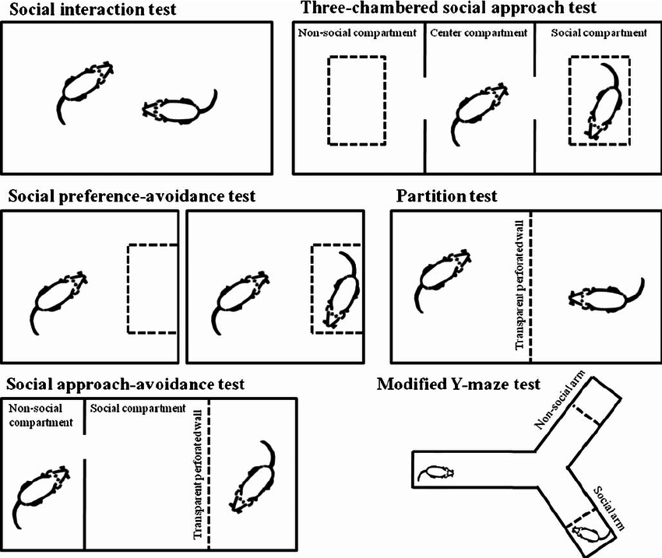
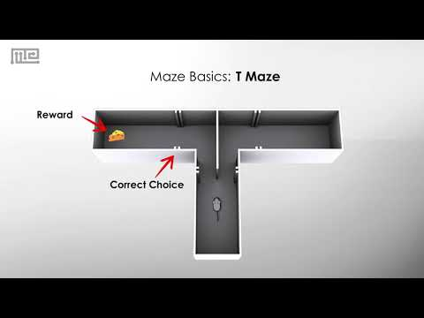
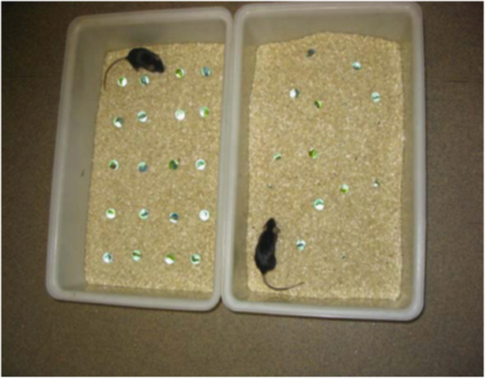
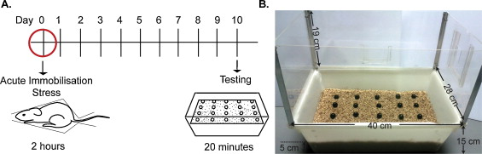
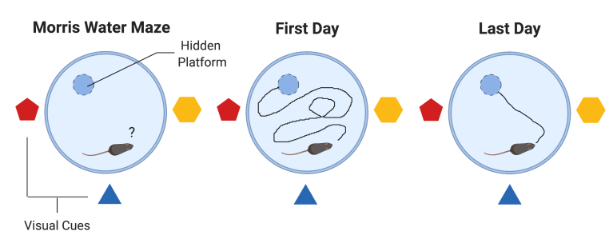
Introducing Neuroscience:Social Behavior and Animals
Notes:
Behavioral Assay
Morris Water maze - (hippocampus and prefrontal cortex)measuring spatial navigation and reference memory.
VIdeo tracked using Any Maze
measure a variety of memory and navigation tasks, as the test animal swims to the platform from various locations, or tries to find the platform after it has been removed
Many of our measurement protocols incorporate video tracking and photocell technology,
and we use SAS programs to analyze and present the captured data.
Novel Objection Recogition -We measure time spent exploring the novel object, that if sufficiently preferred by the animal is a reflection of intact memory for the original objects.
Forced swim - stress test
light/Dark - locomotion
Object Burying:This test places a grid of foreign objects (marbles) in a standard cage filled with bedding (measured to a standard depth). Animals are tested for 30 minutes, and the number of objects buried is recorded. This is a test of defensive anxiety.

Slide 5
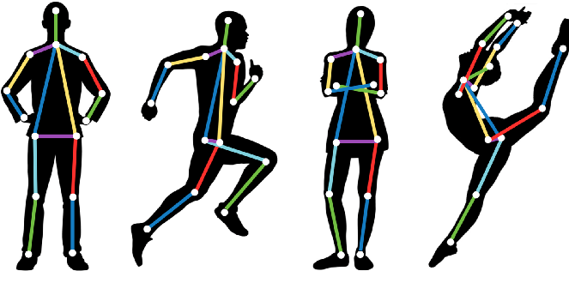
Square One
What is Pose estimation
DeepLabCuts is actually a modified version of DeeperCut a neural network created by other researcher to detect and label human poses in videos
Usually have to train the networks by showing them thousands of hand-labeled frames
If you want to label a different species, moving in a different way you need to repeat the training over

Slide 6
Background on Mathias
Many neuroscience , psychiatry and social behaviors studies involve students and technicians to code/score videos of behaviors frame by frame for long periods of time.
The story is that Dr. A. Mathias was trying to understand the neuroscience of smell by watching mice as they track trials of scent. He needed a way of marking the tip of the snout
Researcher would often dab paint or reflective glue on body parts of interest but to do that on the tip of a snout was not very feasible. He tried different software and behavioral methods to no avail so he [ and his partner ] decided to create their own package.

Slide 7
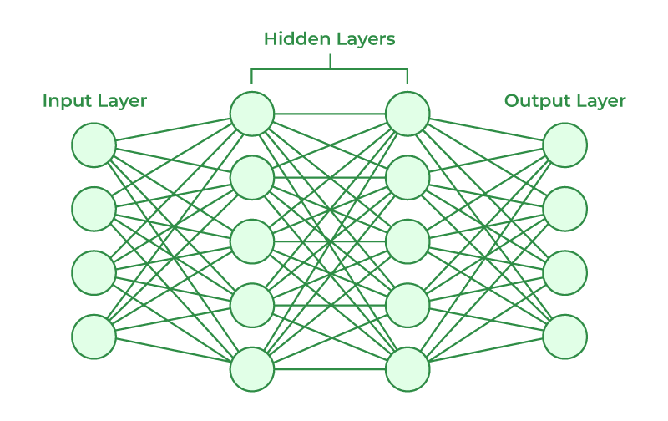
Neural Networks
Also called Deep learning
has been in and out of fashion since 1944. It were first proposed by Warren McCullough and Walter Pitts at MIT
a type of machine learning- where a computer performs tasks by analyzing training examples
Usually the samples have been hand labeled
EX: object recognition system
Notes:
Is a method of artificial intelligence that teaches computers to process data similar to that of the human brain. It also called deeper learning- which uses interconnected nodes or neurons in a layered structure that resembles the brain. IT creates an adaptive system that computers use to learn from their mistakes an =d continuously i

Slide 8
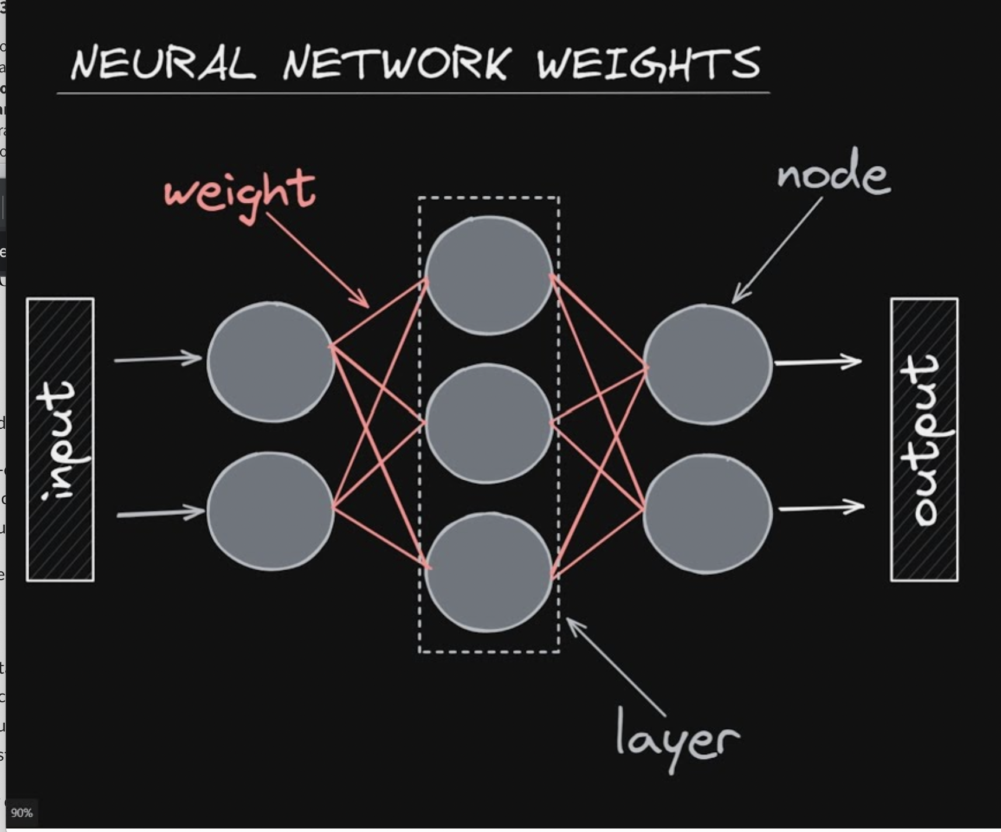
How Do They Work
Simple neural network architecture
Mimic the behavior of the human brain
Human brain is the inspiration behind neural networks agriculture
Human brain cells = neurons;form a highly interconnected network and send electrical signals to each other to help process information
Artificial neurons are software modules called nodes and article neural networks are software programs or algorithms using computing to solve regression and classification problems
Notes:
Input layer: info form the outside world enters the artificial brain form the input layer. Input nodes process the data, analyze or categrze it and then pass to the next layer. Hidden layer: takes the input from the input layer of other hidden layers. Each hidden layer analyzes the output from the previous layer, processes it further and passes it on to the next layer
Output layer: gives the finial results of all the data processing by the artificial neural network. It can be a sigle or multiple nodes
Weight is the parameter within a neural network that transforms input data within the network's hidden layers. A neural network is a series of nodes, or neurons. Within each node is a set of inputs, weight, and a bias value. As an input enters the node, it gets multiplied by a weight value and the resulting output is either observed, or passed to the next layer in the neural network. Often the weights of a neural network are contained within the hidden layers of the network.
nput layer: info form the outside world enters the artificial brain form the input layer. Input nodes process the data, analyze or categrze it and then pass to the next layer. Hidden layer: takes the input from the input layer of other hidden layers. Each hidden layer analyzes the output from the previous layer, processes it further and passes it on to the next layer
Output layer: gives the finial results of all the data processing by the artificial neural network. It can be a sigle or multiple nodes

Slide 9
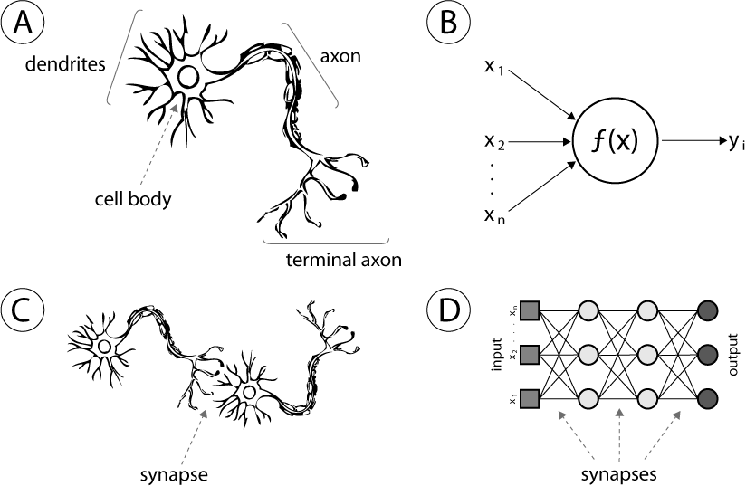
Neural Networks
Notes:
If you see in the image above, it compares the structure of a neuron in an animal brain (left) and a neuron in a neural network (right).
The dendrites serve as the portion of the neuron that accepts multiple “input” signals, and through the cell body and the axon, it outputs through the terminal axon. This is exactly how a neuron in a neural network works as well
– multiple inputs that are processed through a function and outputs a value. The involvement of synapses in both cases are very similar. In fact, using the same terminologies directly prove the correlation and relevance between the animal brain/neuron and the artificial neural network.

Slide 10
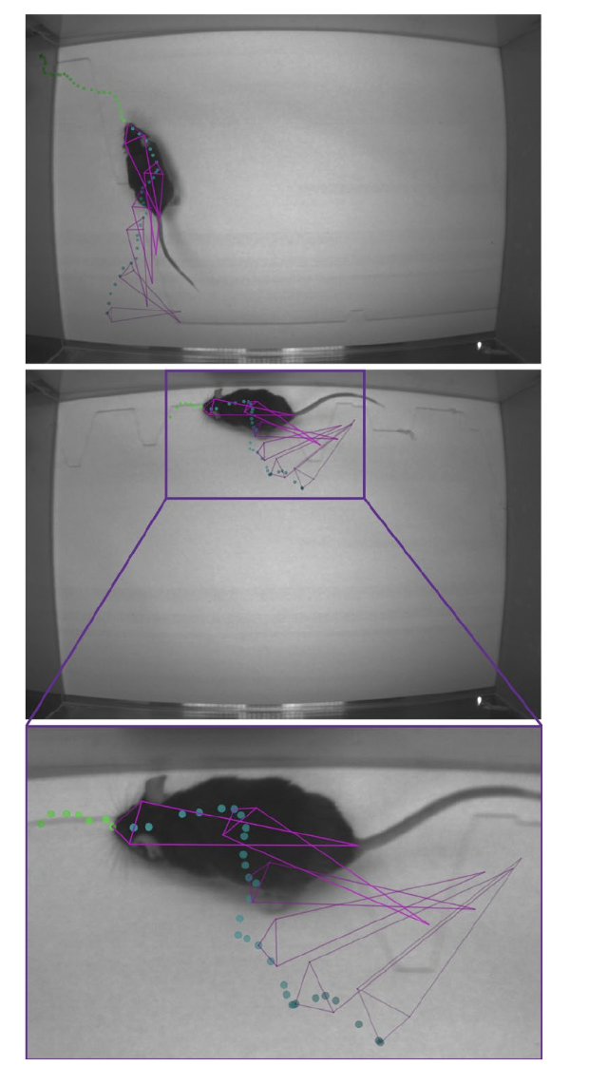
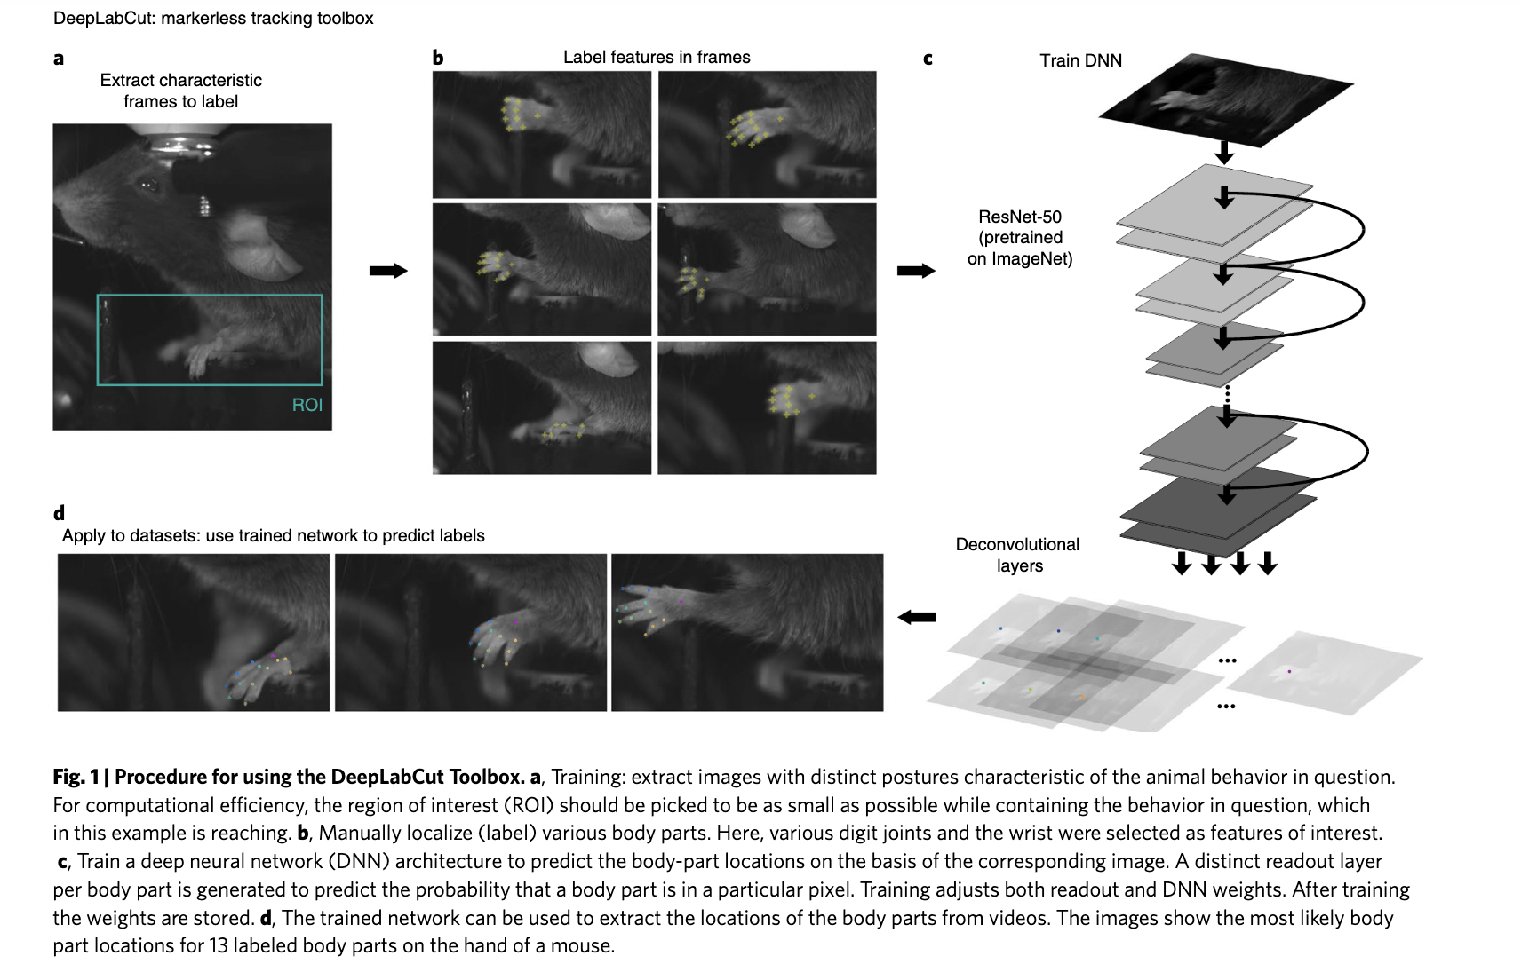
The coding background

Slide 11
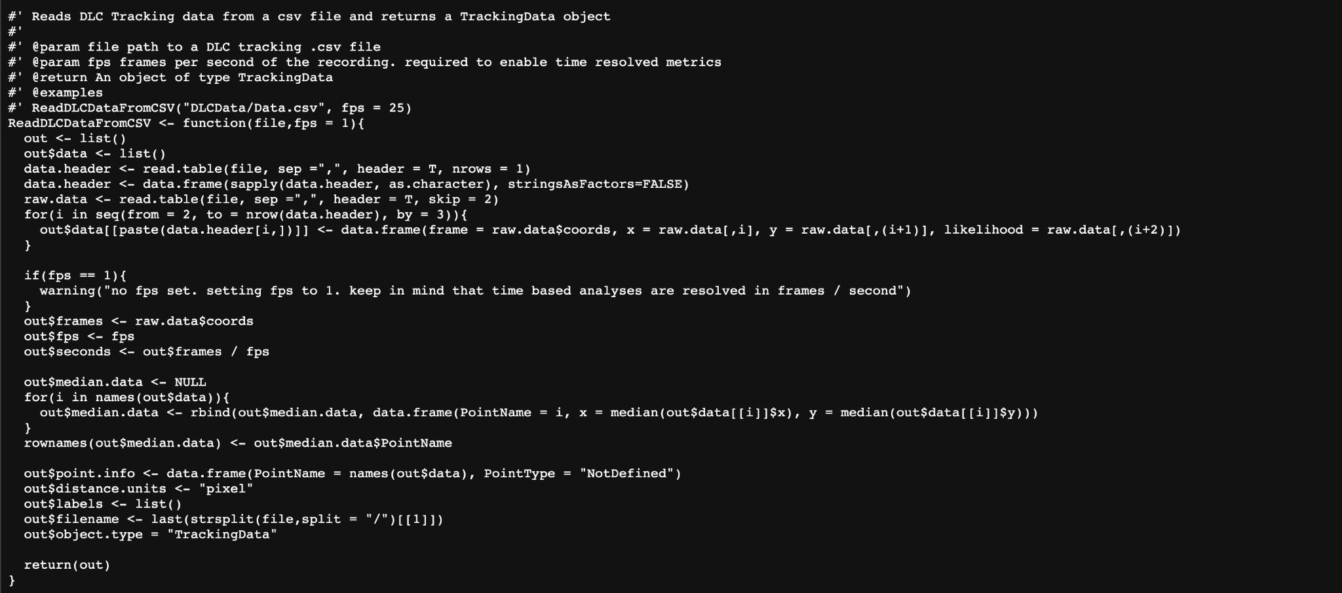
R Script
Link: https://github.com/ETHZ-INS/DLCAnalyzer

Slide 12
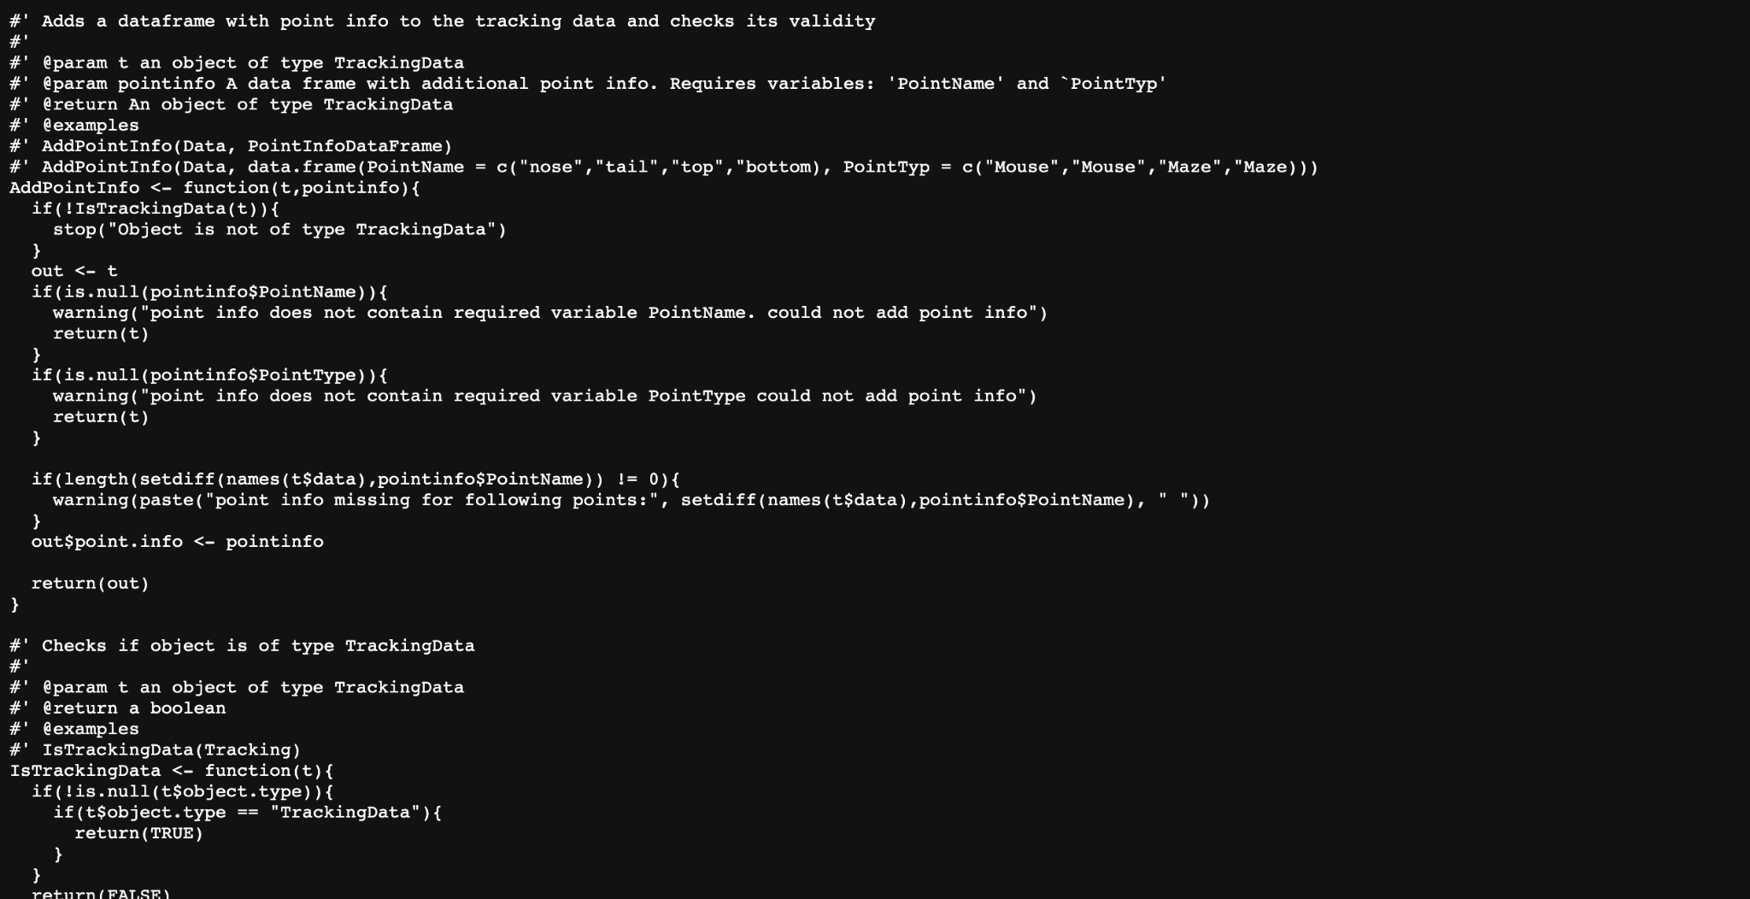

Slide 13
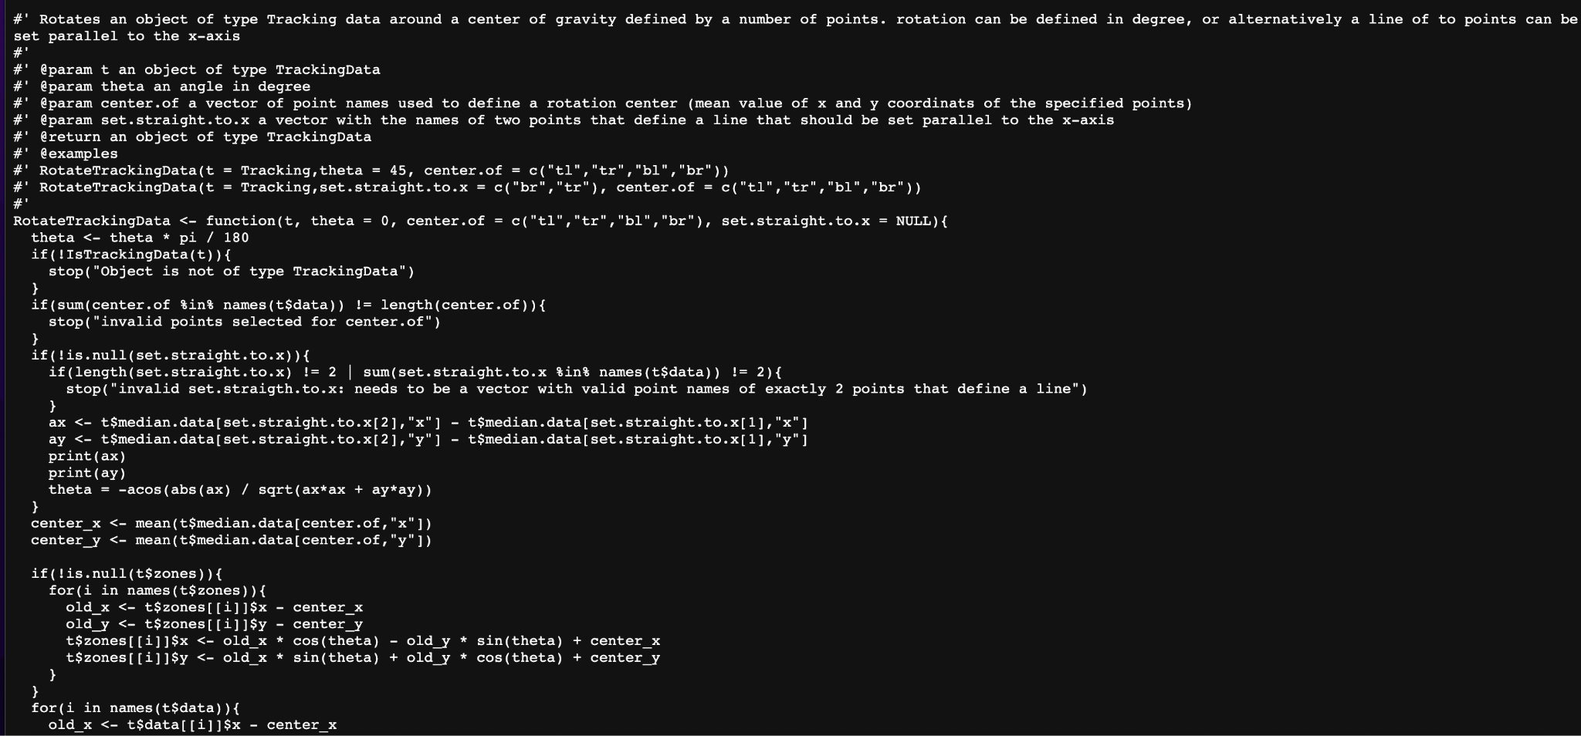

Slide 14

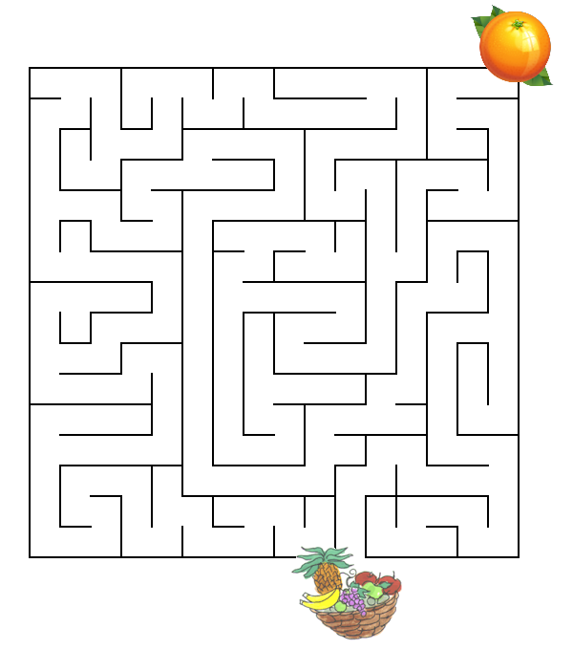
My experience and my Thoughts

Slide 15
References
https://www.nature.com/articles/s41598-020-62089-6

